Slide 1

Sentiment Analysis for Enhancing Customer Experience in travel and Hospitality
BY
Amer Sohail Shaik
Mohammad Abdul Imran

Slide 2

Project Objective
The goal is to design a sentiment analysis model that categorizes hotel reviews into positive or negative sentiments.
This model will offer actionable insights by automatically separating positive and negative feedback, helping hotels focus on key areas.
By analysing guest sentiments, hotels can better understand customer experiences and make data-driven improvements to their services.

Slide 3
Dataset
Dataset: Hotel Review System Dataset
Structure:
Training Set: 38,932 reviews
Test Set: Separate file for evaluation
Data Composition:
68% Positive Reviews
32% Negative Reviews
Key Features:
user_id: Unique identifier for each reviewer
description: Review text containing customer feedback
browser_used: Browser used by the reviewer
device_used: Device type (e.g., mobile, desktop)
is_response: Indicates if the review received a response

Slide 4
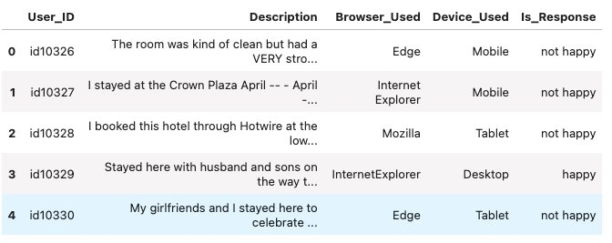
Dataset Sample

Slide 5
Dataset preprocessing
Initial Steps:
Retained only the description and is_response columns.
Checked for and removed empty or null entries.
Text Cleaning:
Standardized all text by converting it to lowercase.
Removed unnecessary characters such as punctuation, special symbols, numbers, and newline characters.
Applied a custom cleaning function to ensure text consistency and readability for sentiment analysis.
Outcome: Cleaned text data, free of noise, ready for further analysis and model training.

Slide 6
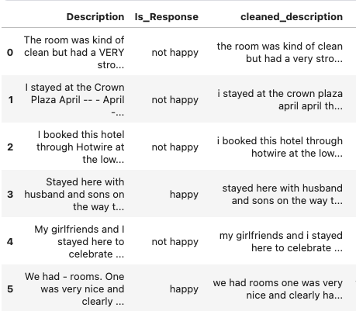
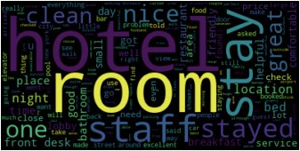
Preprocess cleaned data
Common words in data

Slide 7
NLP Techniques
NLP Techniques for Sentiment Analysis:
Bag of Words (BoW): Represents text data as word frequency vectors.
TF-IDF: Weighs words by their importance in a document relative to the entire dataset.
Word Embeddings: Captures semantic meaning of words using techniques like Word2Vec, GloVe, or FastText.
Transformer Models: Leverages deep learning for context-aware understanding (e.g., BERT, DistilBERT).
Solving Sentiment Analysis with NLP:
Text Preprocessing: Clean and prepare text data.
Feature Extraction: Convert text into numerical representations using NLP techniques.
Model Training: Train machine learning or deep learning models on labeled sentiment data.
Evaluation: Assess model performance using metrics like accuracy, precision, recall, and F1-score.
Approach:
Implementing DistilBERT, a lightweight version of BERT, to classify hotel reviews as positive or negative.

Slide 8
Model - DistilBERT
BERT (Bidirectional Encoder Representations from Transformers)
Transformer-based pre-trained model designed for understanding the context of words in a sentence.
Utilizes bidirectional attention, considering both left and right context of words.
Highly effective for various NLP tasks (e.g., sentiment analysis, question answering).
DistilBERT
A smaller, more efficient version of BERT, based on the same transformer architecture.
Uses Knowledge Distillation to train a smaller model ("student") to mimic the larger BERT model ("teacher").
Achieves high accuracy while being 40% smaller and 60% faster than BERT.
Key Differences:
DistilBERT has 6 layers compared to BERT’s 12 layers, resulting in faster inference and reduced model size.
DistilBERT retains most of BERT’s accuracy while being more computationally efficient.

Slide 9
Process
Goal: Classify hotel reviews as positive or negative based on their content.
Steps:
Preprocessing: Clean the review text (remove unwanted characters, tokenize, convert to lowercase).
Tokenization: Convert the text into tokens using DistilBERT’s pre-trained tokenizer, which splits text into smaller units (tokens) that the model can understand.
Contextual Embeddings: The tokenized text is passed through DistilBERT to generate contextual embeddings for each word, capturing both left and right context.
Classification: The embeddings are fed into a classification head that predicts whether the review sentiment is positive or negative.
Fine-Tuning: DistilBERT is fine-tuned on labeled review data, ensuring it is optimized for sentiment classification tasks.

Slide 10
Fine-Tuning Process for Sentiment Classification
Data Split:
Split the dataset into training and validation sets to evaluate model performance.
Tokenization:
Reviews are tokenized using DistilBERT's tokenizer with a max length of 512 words.
Padding is enabled to ensure all reviews have uniform length, and truncation is set to ensure reviews longer than 512 words are appropriately truncated.
Model Training:
Utilized the Hugging Face Transformers library for training, using DistilBERT pre-trained on the SST-2 dataset (distilbert-base-uncased-finetuned-sst-2-english).
Batch Size: Set to 32 for efficient processing during training.
Epochs: Set to 10 for sufficient model fine-tuning.
Early Stopping: Implemented with a patience of 3 epochs to avoid overfitting and stop training if validation performance does not improve.
Advantages of Fine-Tuning:
By leveraging pre-trained weights from distilbert-base-uncased-finetuned-sst-2-english, the model benefits from prior training on sentiment-related tasks, leading to better performance on hotel review sentiment classification.

Slide 11
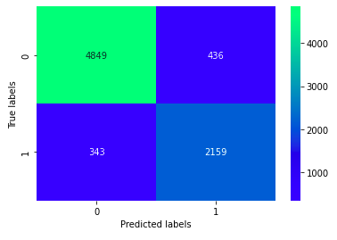
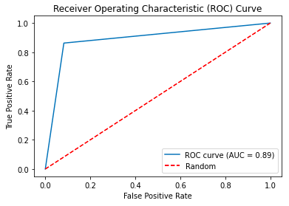
Results
class | precision | recall | F1-score
positive | 0.93 | 0.92 | 0.93
Negative | 0.83 | 0.86 | 0.85
Table : Evaluation metrics values on test data
Confusion matrix

Slide 12
conclusion
Applied DistilBERT for sentiment analysis on hotel reviews, achieving high accuracy with reduced computational requirements.
The fine-tuning process using pre-trained weights and early stopping ensures efficient real-time sentiment classification for positive and negative feedback.

Slide 13
References
Data : https://www.kaggle.com/datasets/anu0012/hotel-review/data
https://huggingface.co/docs/transformers/en/model_doc/distilbert
https://github.com/UviniR/Reviews-Sentiment-Analysis

Slide 14

Thank you

